Slide 1
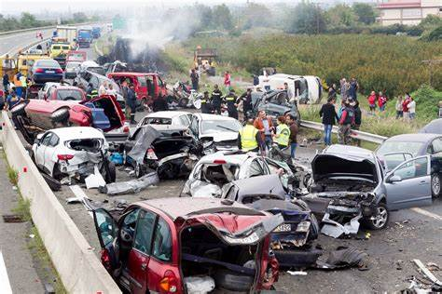
Project 3: Car Accidents (2019)
Alexandre Maule, Sean smith, Isidore Lozano, Jonathan yang

Slide 2
Resources Used
NHTSA CRSS Accident Records (2016-2020)
US Traffic Accidents
JavaScript Library
Chart.js

Slide 3

Research Questions
Which Region of the US has the worst drivers?
Does time influence the number of accidents?
Which Make gets into accidents more frequently?
What is the severity of damage and frequency of each region?

Slide 4
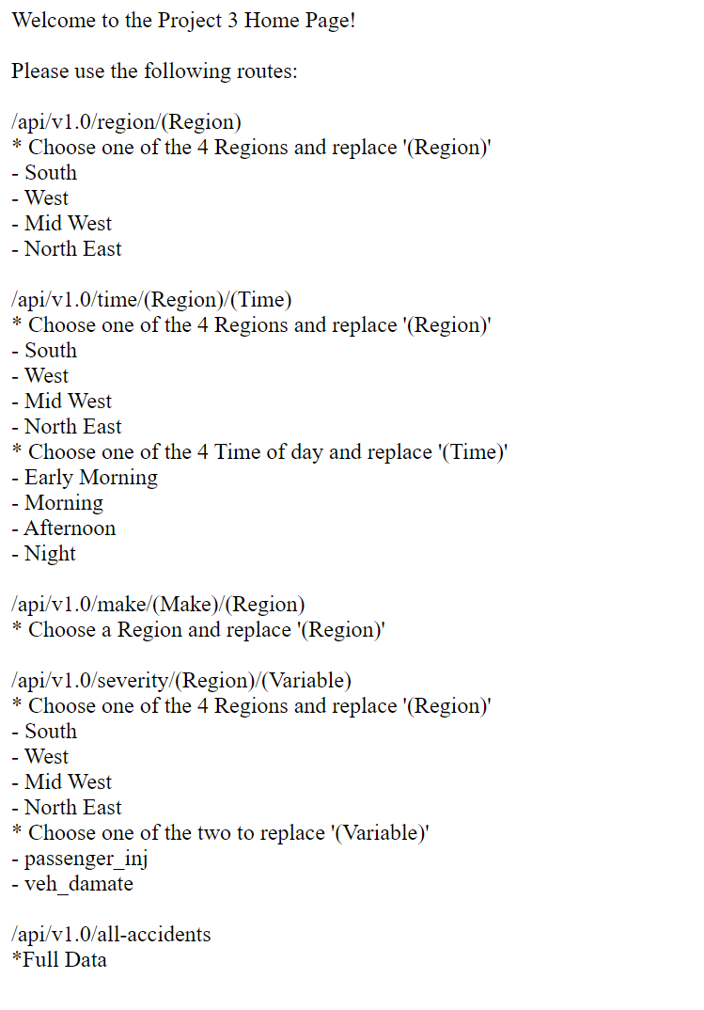
Dataset/SQLite/Flask
Cleaning up the data
Creating SQLite database
Creating Flask API

Slide 5
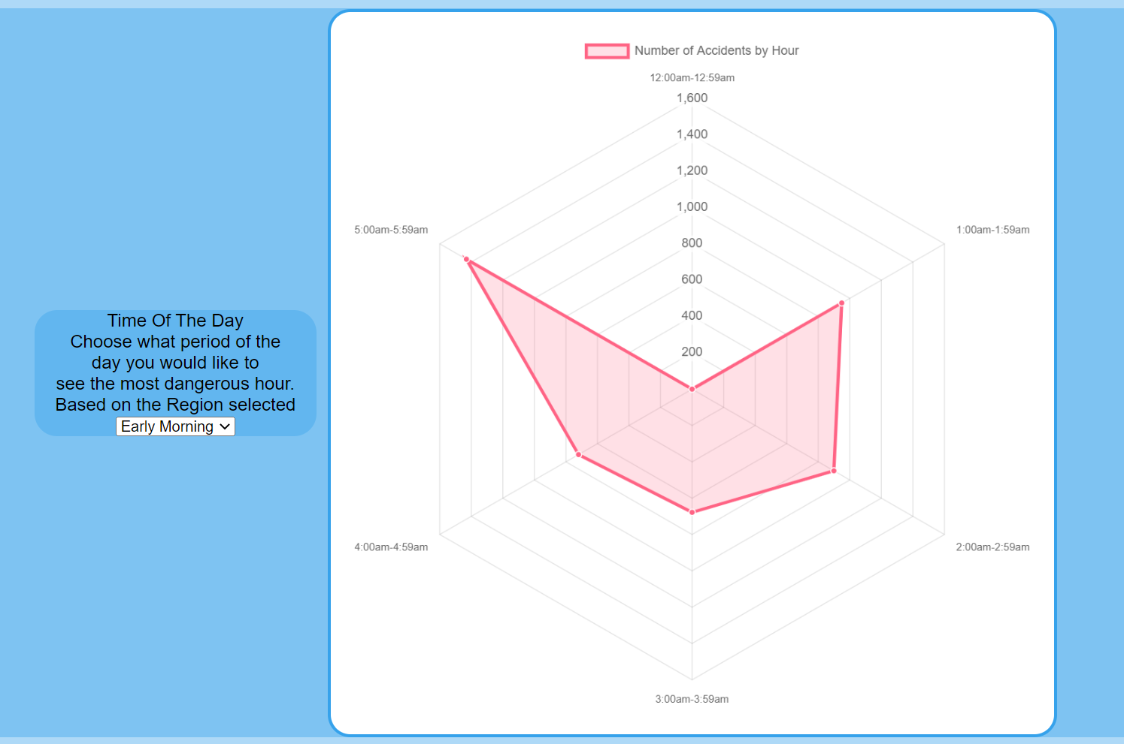
Chart.js (Radar)

Slide 6
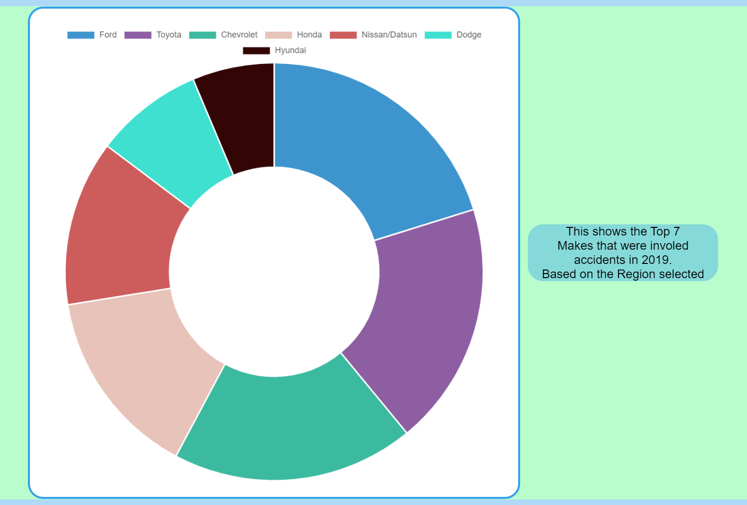
Chart.js (Donut)

Slide 7
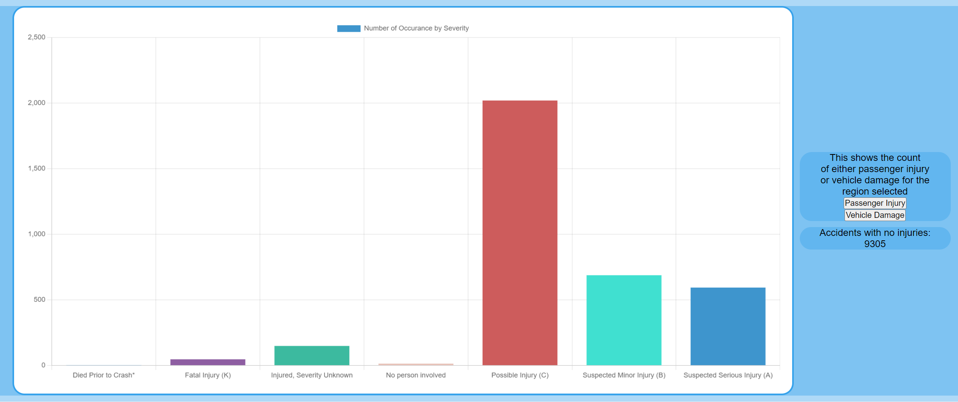
Chart.js (Bar)

Slide 8
DEMO

Slide 9
Conclusions
Which Region of the US has the worst drivers?
The southern region had the most car accidents in 2019.
Does time influence the number of accidents?
Yes, there are clear indicators showing certain hours with a high rate of accidents.
Which Make gets into accidents more frequently?
Ford vehicles were the top Make for accidents in 2019.
What is the severity of damage and frequency of each region?
The most common severity in all four region was “No Injury”

Slide 10
Limitations
Only used 2019 Data
Only looked at US car accidents
Didn’t investigate every detail regarding the accidents
Ex: Weather, Alcohol involvement, actions before accident, and number of people involved.
Not all accidents reported
Differences in population density per region.

Slide 11
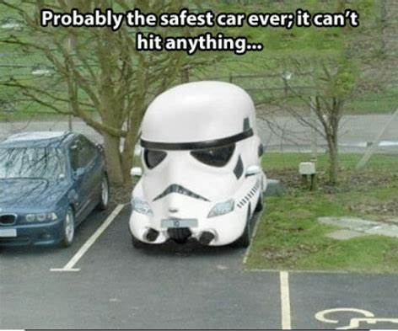
Questions?

